Slide 1
MANTHAN MINI HACKATHON – ELECTRIC EPOCHS
India Tech Career Intelligence 2026
Turning 100,000 job postings into clear guidance for students
1
2
3
4
5
Dhanush
Sravanth
Vaishnavi
Tarani
Mounika
Data collection, cleaning & quality audit
Job categories, roles & company analysis
Skill demand analysis
Location, work mode & experience analysis
Salary, stipend & compensation analysis
Notes:
Introduce the project and the five members with their responsibilities. Replace Member 1-5 with real names.

Slide 2





THE PROBLEM
Students have thousands of postings but few clear answers
Which skills should I learn?
Which city should I search in?
Remote, hybrid or on-site?
How does pay compare across roles?
What should I look for in an internship?
Chart 1: skill sets by job title
Chart 2: postings by city
Chart 3: work mode by category
Chart 4: full-time salary by category
Chart 5: internship stipend range
WHY IT IS HARD TO ANSWER
100,000 postings: across 6 job categories and 33 columns, too many to read by hand
Different pay types: Full-time pay and internship pay need to be checked separately.
Gaps in the data: one column has missing values, and skill lists repeat in only 6 patterns
OUR GOAL
Use data to turn job postings into simple, practical career guidance.
We describe what the dataset shows. We do not predict the future or claim to cover the whole job market.
India Tech Career Intelligence 2026 | Manthan Mini Hackathon
2
Notes:
Explain the career-information problem in simple words, then show which chart answers which question.

Slide 3
DATASET & APPROACH
A clean, verified dataset of 100,000 postings is our base
100,000
33
33,499
0
6
records
columns
missing values, all in probation_period
duplicate records in the raw data
unique skill-list patterns
HOW WE WORKED
1. Audit the raw data
▶
2. Clean without losing records
▶
3. Analyse by topic
▶
4. Turn findings into actions
WHAT THE DATA COVERS
QUALITY CHECKS WE DID
6 job categories, each with about 16,400 to 16,900 postings
Full-time 59,871 (59.87%) and internship 40,129 (40.13%)
Salary and stipend kept separate, all in INR
Skills, cities, work modes and pay in one table
No hidden blanks or placeholder values in text columns
No salary range where minimum is above maximum
Only missing field: probation_period (33.50%)
13,448 repeated title, company, city and date postings kept, as they come from different platforms
Limit to remember: this is not the entire Indian job market, and only 6 skill-list patterns means skill results need more validation.
India Tech Career Intelligence 2026 | Manthan Mini Hackathon
3
Notes:
Verified facts: 100,000 rows, 33 columns, 33,499 missing in probation_period, 0 exact duplicates, 6 unique skill-list patterns.

Slide 4
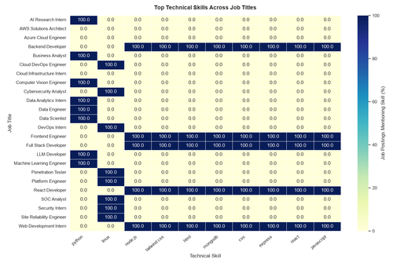
CHART 1 | SKILLS
Skills group into a few role-based bundles
KEY FINDING
Each job title shows a clear skill set: a skill is either 100% or 0% for that title.
Python leads data and AI titles, Linux leads security and DevOps titles, and web titles share a web stack (Node.js, HTML, CSS, React).
BUSINESS IMPACT
Students can see which skills go with which role.
It helps them decide what to learn first instead of guessing.
Top technical skills across job titles (% of postings)
FROM OUR DATA
RECOMMENDED ACTION
Python appears in 33,212 postings (33.21%) and Linux in 33,134 (33.13%).
Every posting lists 6 to 8 skills.
Limit: only 6 unique skill-list patterns repeat across 100,000 postings, so results need more validation.
Build role-based learning roadmaps for target roles.
Check each roadmap against real job descriptions before finalising it.
India Tech Career Intelligence 2026 | Manthan Mini Hackathon
4
Notes:
The heatmap is small in the source image; point to the groups: web titles, data/AI titles, security/DevOps titles.

Slide 5
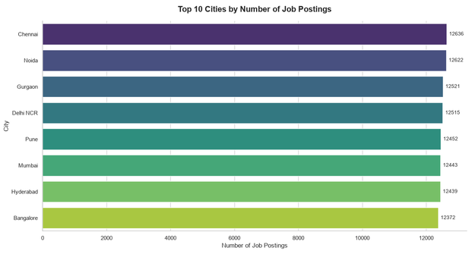
CHART 2 | CITIES
Top cities have very similar posting counts
KEY FINDING
Among the 8 cities shown, postings range from 12,372 (Bangalore) to 12,636 (Chennai).
The gap is only about 2%.
BUSINESS IMPACT
City size alone does not separate the options.
Role fit and work mode matter more when postings are this even.
Number of job postings by city (counts labelled on bars)
FROM OUR DATA
RECOMMENDED ACTION
Median full-time pay is also close across hubs: ₹8.46L (Chennai) to ₹8.52L (Mumbai).
Each hub has about 7,400 to 7,600 full-time salary records.
Limit: these are postings in our dataset, not live vacancies.
Compare posting counts by city, then narrow by preferred role and location.
Do not treat counts as open vacancies.
India Tech Career Intelligence 2026 | Manthan Mini Hackathon
5

Slide 6
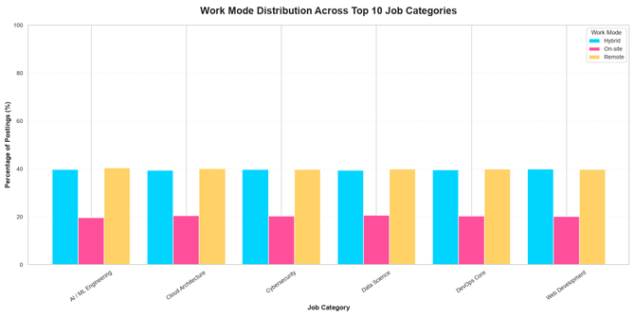
CHART 3 | WORK MODE
Work-mode mix looks similar in every job category
KEY FINDING
In all six categories, Hybrid and Remote bars are close in height.
On-site is the lowest bar in every category.
BUSINESS IMPACT
Work mode does not change much by field.
Students can pick a field and a work mode separately.
Work mode share (%) across job categories
FROM OUR DATA
RECOMMENDED ACTION
The dataset records three work modes: Remote, Hybrid and On-site.
Each of the 6 categories has about 16,400 to 16,900 postings.
Note: shares are read from the chart, so we do not quote exact percentages.
Add Remote, Hybrid and On-site filters to job search.
Combine them with city and role to shortlist faster.
India Tech Career Intelligence 2026 | Manthan Mini Hackathon
6

Slide 7
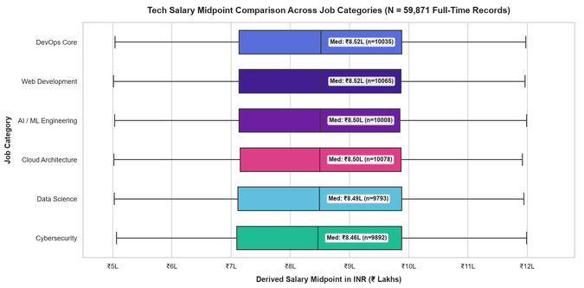
CHART 4 | SALARY
Median pay is almost the same across job categories
KEY FINDING
Medians sit between ₹8.46L and ₹8.52L in all six categories.
The middle 50% of each category spans roughly ₹7.1L to ₹9.9L.
BUSINESS IMPACT
Changing field only for pay gives little gain in this data.
The dataset does not state the pay period, so we do not assume one.
Derived salary midpoint (full-time, n = 59,871)
FROM OUR DATA
RECOMMENDED ACTION
All 59,871 full-time postings are in INR and ask for 2 to 4 years of experience.
No salary range has its minimum above its maximum.
No statistical outliers were found, so no records were removed.
Compare full pay ranges, not single numbers.
Choose a category by interest and skills, and do not assume take-home pay.
India Tech Career Intelligence 2026 | Manthan Mini Hackathon
7

Slide 8
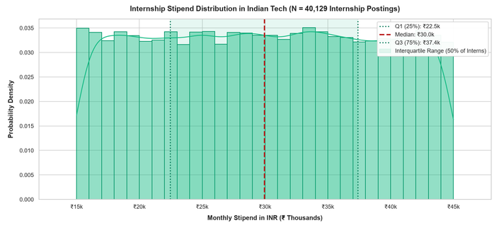
CHART 5 | INTERNSHIPS
Internship stipends spread widely from ₹15k to ₹45k
KEY FINDING
Median stipend is ₹30.0k, with the middle 50% between ₹22.5k and ₹37.4k.
Stipends run from ₹15k to ₹45k and are spread fairly evenly.
BUSINESS IMPACT
Two internships can pay very differently.
In this data, all 0 to 1 year postings are internships, so they are the main entry route.
Internship stipend distribution (n = 40,129 postings)
FROM OUR DATA
RECOMMENDED ACTION
40,129 internship postings make up 40.13% of the dataset.
Median stipend by category is close: ₹29.7k (Web Development) to ₹30.1k (AI / ML).
Stipend figures come from the chart's monthly stipend axis.
Weigh stipend with learning, relevant skills and experience.
Prefer internships that match the skills in your target role.
India Tech Career Intelligence 2026 | Manthan Mini Hackathon
8

Slide 9

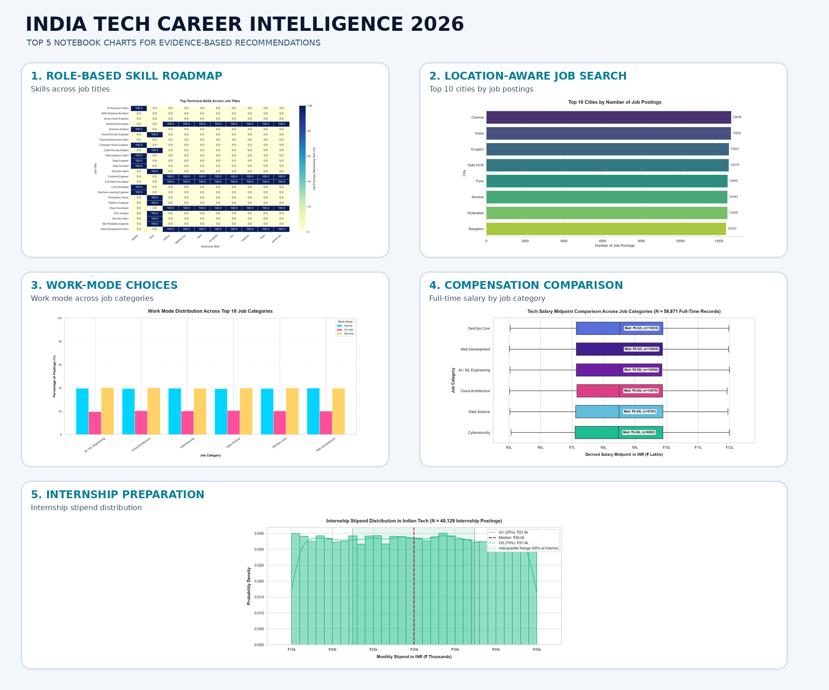

RECOMMENDATIONS
Five practical recommendations for students
1. Build role-based skill roadmaps
EVIDENCE BEHIND THE ADVICE
Our skills chart shows job titles grouping into clear skill sets. Use this to plan what to learn first, and check each roadmap against real job descriptions.
2. Search smarter by city and role
Cities have similar posting counts (12,372 to 12,636), so city alone won't decide. Compare counts by city, then narrow by preferred role and location.
3. Filter by work mode
The Remote, Hybrid and On-site mix looks similar across categories. Filters help students match jobs to how they prefer to work.
Our five charts
4. Compare pay and stipend with the full picture
PROPOSALS, NOT BUILT YET
Median pay is close across categories and stipends range widely. Look at responsibilities, skills, learning and experience, not just the number.
These are ideas based on our descriptive analysis. Career prediction would need enough historical data and proper model validation first.
5. Refresh and check the data regularly
Update the dataset, then check for missing values, duplicates, inconsistent and outdated entries before giving advice.
India Tech Career Intelligence 2026 | Manthan Mini Hackathon
9
Notes:
Recommendations are based on verified findings; features such as filters and roadmaps are proposals, not yet implemented. Prediction is a future possibility only.

Slide 10

Thank You
By ELECTRIC EPOCHS
Manthan Mini Hackathon | India Tech Career Intelligence 2026

